Slide 1
Relationship of deaths from Pneumonia and Influenza
Zhongyi Troy Zhang; Yuying Gao; Qier An
Spring 2019
MScBMI 32000

Slide 2
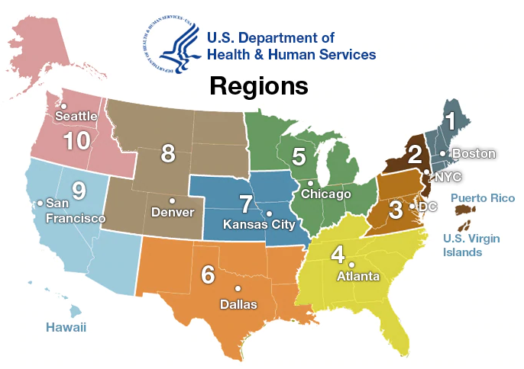
Background Information
Influenza
Pneumonia
Data Resource: Deaths from Pneumonia and Influenza (P&I) and all deaths
Publisher: Centers for Disease Control and Prevention
URL:
https://healthdata.gov/dataset/deaths-pneumonia-and-influenza-pi-and-all-deaths-state-and-region-national-center-health
Data Cleaning

Slide 3
Data Manipulation
Original headers
State
Age
Season
MMWR Year/Week
Deaths from Influenza
Deaths from pneumonia
All deaths
Percentage of deaths due to pneumonia or influenza
Cleaned headers
Region
Age group
Season
Year
MMWR
Deaths from Influenza
Death from pneumonia
Ration between deaths

Slide 4
Summary Statistics (Region Chart)
 | Death from Influenza (n=38962) | Death from Pneumonia (n=908108)
Region
1, n(%) | 2424 (6.22) | 46544 (5.13)
2, n(%) | 2644 (6.79) | 82375 (9.07)
3, n(%) | 3749 (9.62) | 87605 (9.65)
4, n(%) | 7087 (18.19) | 194014 (21.36)
5, n(%) | 7193 (18.46) | 152083 (16.75)
6, n(%) | 4254 (10.91) | 111864 (12.32)
7, n(%) | 2789 (7.16) | 44589 (4.91)
8, n(%) | 1720 (4.41) | 26647 (2.93)
9, n(%) | 4794 (12.30) | 130769 (14.40)
10, n(%) | 2308 (5.92) | 31618 (3.48)
Season
Spring (group 1), n(%) | 10704 (27.47) | 239862 (26.41)
Summer (group 2), n(%) | 912 (2.34) | 190025 (20.93)
Fall (group 3), n(%) | 1227 (3.15) | 1227 (21.85)
Winter (group 4), n(%) | 26119 (67.04) | 26119 (30.81)
Week, beta (95% CI) | -0.85 (-0.93, -0.76) | -2.47 (-3.01, -1.92)
Year
2014, n (%) | 5511 (14.14) | 178334 (19.64)
2015, n (%) | 6331 (16.25) | 187904 (20.69)
2016, n (%) | 3831 (9.83) | 178447 (19.65)
2017, n (%) | 8230 (21.12) | 180375 19.86)
2018, n (%) | 14563 (37.38) | 174586 (19.23)
2019, n (%) | 496 (1.27) | 8462 (0.93)

Slide 5
Summary Statistics (Age Chart)
 | Death from Influenza (n = 38421) | Death from Pneumonia (n = 907828)
Age
0-17(group 1), n(%) | 800 (2.08) | 4001 (0.44)
18-64 (group 2), n(%) | 8781 (22.85) | 163269 (17.98)
over 65 (group 3), n(%) | 28840 (75.06) | 740558 (81.57)
Season
Spring (group 1), n(%) | 10689 (27.82) | 239856 (26.42)
Summer (group 2), n(%) | 618 (1.61) | 189772 (20.90)
Fall (group 3), n(%) | 1008 (2.62) | 198413 (21.86)
Winter (group 4), n(%) | 26106 (67.95) | 279787 (30.82)
Week, beta (95 % CI) | -2.83 (-3.46, -2.22) | -8.23 (-14.00, -2.45)
Year
2014, n (%) | 5379 (13.81) | 178323 (19.64)
2015, n (%) | 6211 (15.94) | 187899 (20.69)
2016, n (%) | 3719 (9.55) | 178442 (19.65)
2017, n (%) | 8148 (20.91) | 180119 (19.83)
2018, n (%) | 14467 (37.13) | 174583 (19.22)
2019, n (%) | 497 (1.28) | 8462 (0.93)

Slide 6
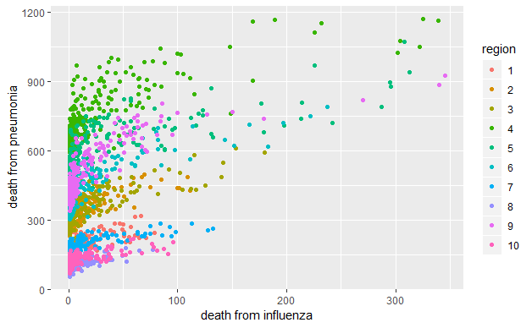
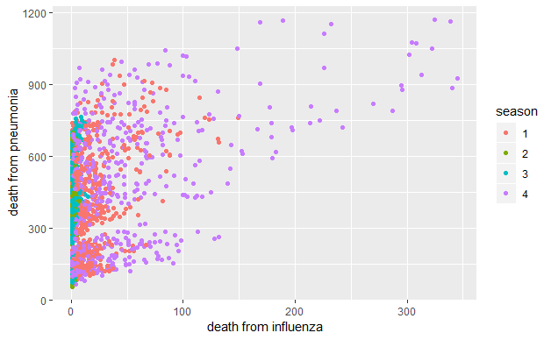
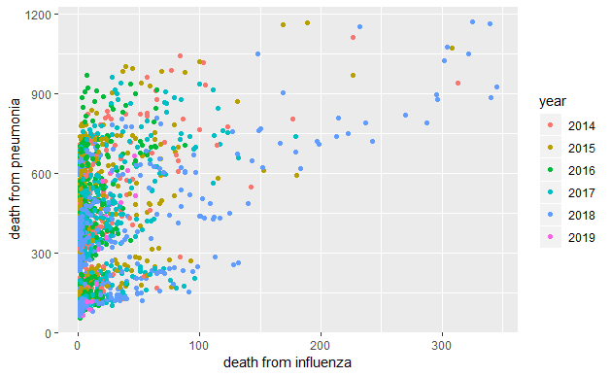
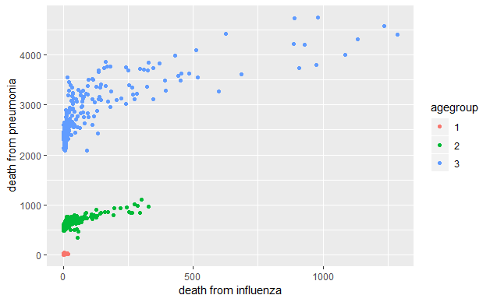
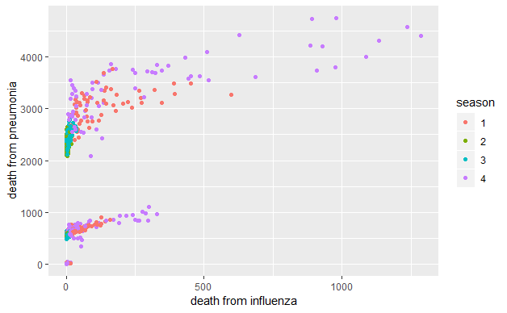
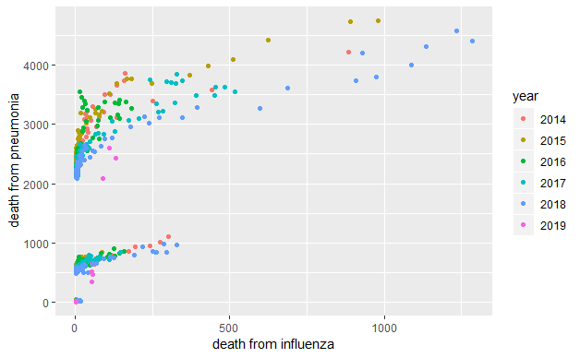
Scatter Plot

Slide 7
Linear Regression Pneumonia ~ Influenza + region + season + year + week
 | Beta | P-value |  | Beta | P-value
Intercept | 211.33 | < 2e-16 | Season 2 | -44.13 | < 2e-16
Influenza | 1.28 | < 2e-16 | Season 3 | -17.89 | 3.63e-10 < 0.01
Region 2 | 134.70 | < 2e-16 | Season 4 | 33.26 | < 2e-16
Region 3 | 150.22 | < 2e-16 | Year 2015 | 7.56 | 0.00247 < 0.01
Region 4 | 539.97 | < 2e-16 | Year 2016 | -4.44 | 0.07565 > 0.01
Region 5 | 379.41 | < 2e-16 | Year 2017 | -12.11 | 1.29e-06 < 0.01
Region 6 | 240.33 | < 2e-16 | Year 2018 | -38.41 | < 2e-16
Region 7 | -9.25365 | 0.008 < 0.01 | Year 2019 | -143.37 | < 2e-16
Region 8 | -72.49 | <2e-16 | Week | -1.04 | < 2e-16
Region 9 | 309.83 | < 2e-16
Region 10 | -56.40 | < 2e-16

Slide 8
Linear Regression Pneumonia ~ Influenza + age + season + year + week
 | Beta | P-value |  | Beta | P-value
Intercept | 144.94 | 1.94e-11 < 0.01 | Year 2015 | 25.60 | 0.188 > 0.01
Influenza | 1.69 | < 2e-16 | Year 2016 | -7.95 | 0.683 > 0.01
Age group 2 | 556.27 | < 2e-16 | Year 2017 | -45.32 | 0.0199 > 0.01
Age group 3 | 2629.91 | < 2e-16 | Year 2018 | -149.45 | < 2e-16
Season 2 | -139.46 | < 2e-16 | Year 2019 | -424.96 | <2e-16
Season 3 | -68.69 | 0.0019 < 0.01 | Week | -2.29 | <2e-16
Season 4 | 69.18 | < 2e-16

Slide 9

Relationship
I =$\frac{Death from Pneumonia}{Death from Influenza}$

Slide 10
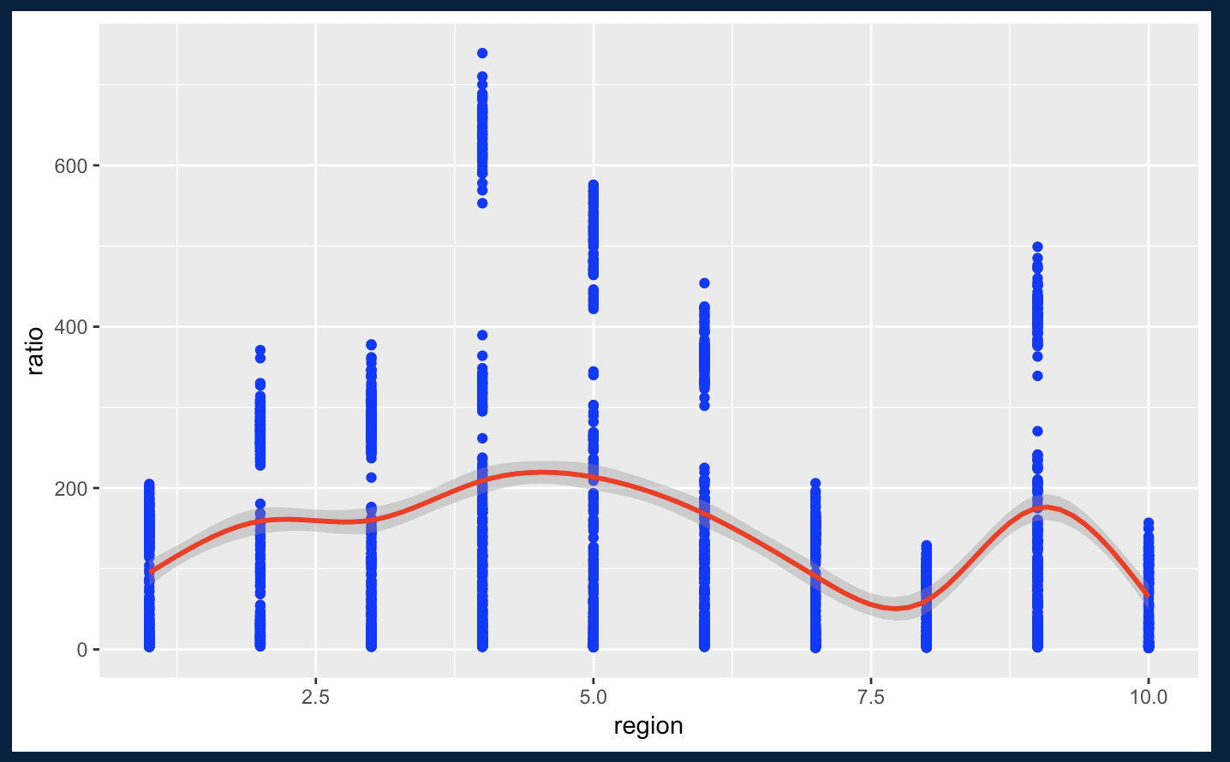
Single Linear Regression I ~ region

Slide 11
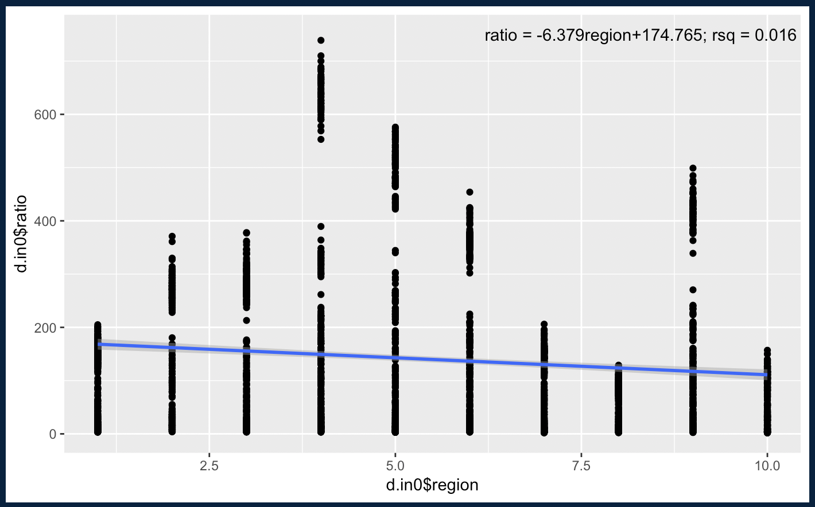
Single Linear Regression I ~ region

Slide 12
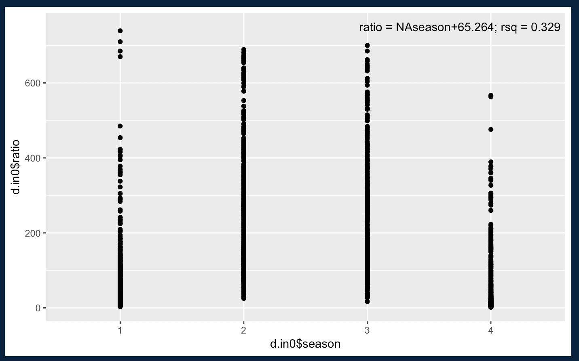
Single Linear Regression I ~ Season

Slide 13
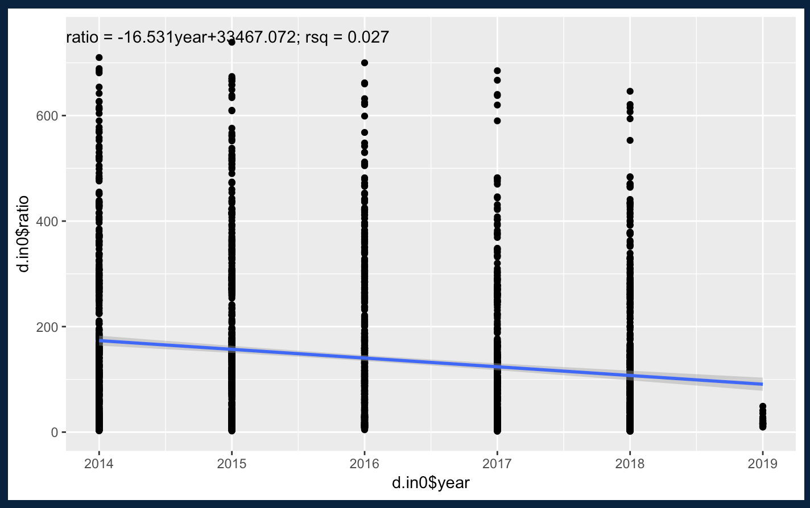
Single Linear Regression I ~ year

Slide 14
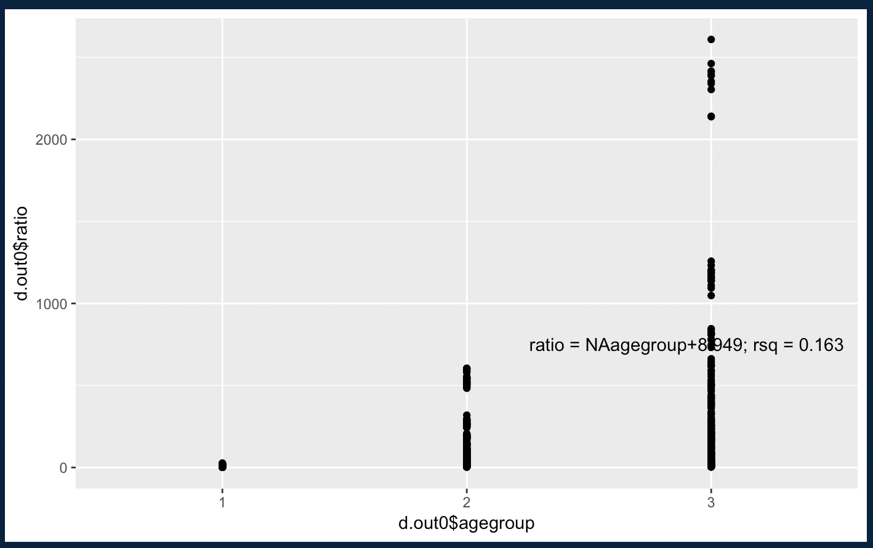
Single Linear Regression I ~ age

Slide 15
Linear Regression I ~ region + season + year + week
 | Beta | P-value |  | Beta | P-value
Intercept | 19.82 | 0.021 > 0.01 | Season 2 | 115.02 | < 2e-16
Region 2 | 64.86 | 2.6e-13 < 0.01 | Season 3 | 111.55 | < 2e-16
Region 3 | 64.38 | 4.07e-13 < 0.01 | Season 4 | -21.85 | 0.0001 < 0.01
Region 4 | 115.00 | < 2e-16 | Year 2015 | 13.83 | 0.028 > 0.01
Region 5 | 118.75 | < 2e-16 | Year 2016 | -12.39 | 0.049 > 0.01
Region 6 | 73.38 | < 2e-16 | Year 2017 | -48.13 | 3.08e-14 < 0.01
Region 7 | -3.36 | 0.703 > 0.01 | Year 2018 | -41.92 | 3.56e-11 < 0.01
Region 8 | -36.54 | 3.62e-05 < 0.01 | Year 2019 | -25.91 | 0.188 > 0.01
Region 9 | 83.22 | < 2e-16 | Week | 1.21 | 1.6e-12 < 0.01
Region 10 | -30.46 | 0.00057 < 0.01

Slide 16
Linear Regression I ~ region + season + year + week
Region 7, Year 2015, 2016 and 2019 do not have a p-value small enough to reject H0.
These three categories do not have significant influence on the relationship between Pneumonia and Influenza
F-statistic = 151.6 on 18 and 2602 DF, p-value < 2.2e-16
R² = 0.5118
Adjusted R² = 0.5085
Suggesting a good fit of the model

Slide 17
Linear Regression I ~ age + season + year + week
 | Beta | P-value |  | Beta | P-value
Intercept | 75.81 | 0.03 > 0.01 | Year 2015 | 6.56 | 0.84 > 0.01
Age group 2 | 130.30 | 1.79e-07 < 0.01 | Year 2016 | -53.78 | 0.096 > 0.01
Age group 3 | 339.69 | < 2e-16 | Year 2017 | -96.66 | 0.003 < 0.01
Season 2 | 317.33 | < 2e-16 | Year 2018 | -101.03 | 0.002 < 0.01
Season 3 | 188.22 | 3.49e-07 < 0.01 | Year 2019 | -56.00 | 0.55 > 0.01
Season 4 | -10.87 | 0.71 > 0.01 | Week | 0.43 | 0.62 > 0.01

Slide 18
Linear Regression I ~ age + season + year + week
Season 4, Year 2015, 2016 and 2019, Weeks do not have a p-value small enough to reject H0.
These four variables do not have significant influence on the relationship between Pneumonia and Influenza
F-statistic = 36.77 on 11 and 774 DF, p-value < 2.2e-16
R² = 0.3432
Adjusted R² = 0.3339
Suggesting an average fit of the model

Slide 19

Cross Validation
Region Chart
Kmeans | Betweenss | Tot.withness
2 | 89855522 | 146746794
3 | 127413634 | 109188682
4 | 151900236 | 84702080
5 | 165076541 | 71525775
6 | 174838127 | 61764189
Age Chart
Kmeans | Betweenss | Tot.withness
2 | 62592817 | 32049783
3 | 79085797 | 15556803
4 | 87775494 | 6867106
5 | 92157245 | 2485355
6 | 92894394 | 1748206

Slide 20
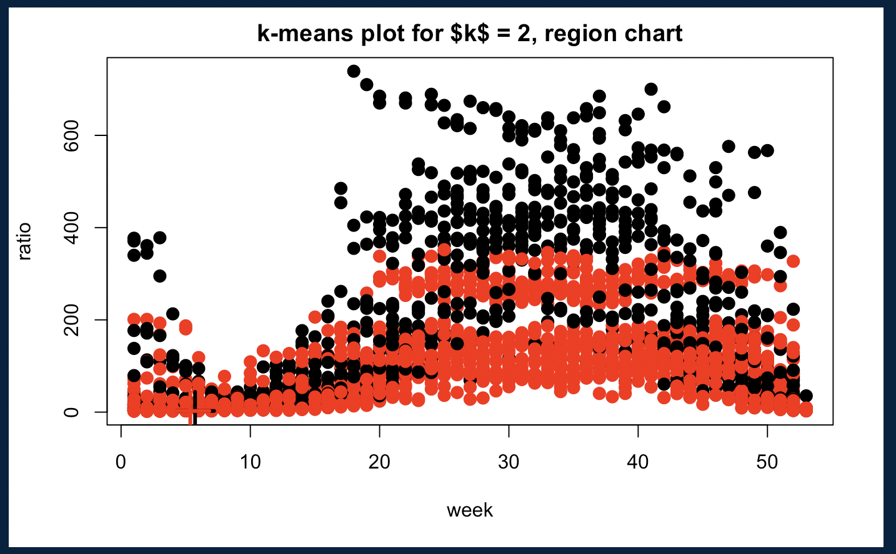
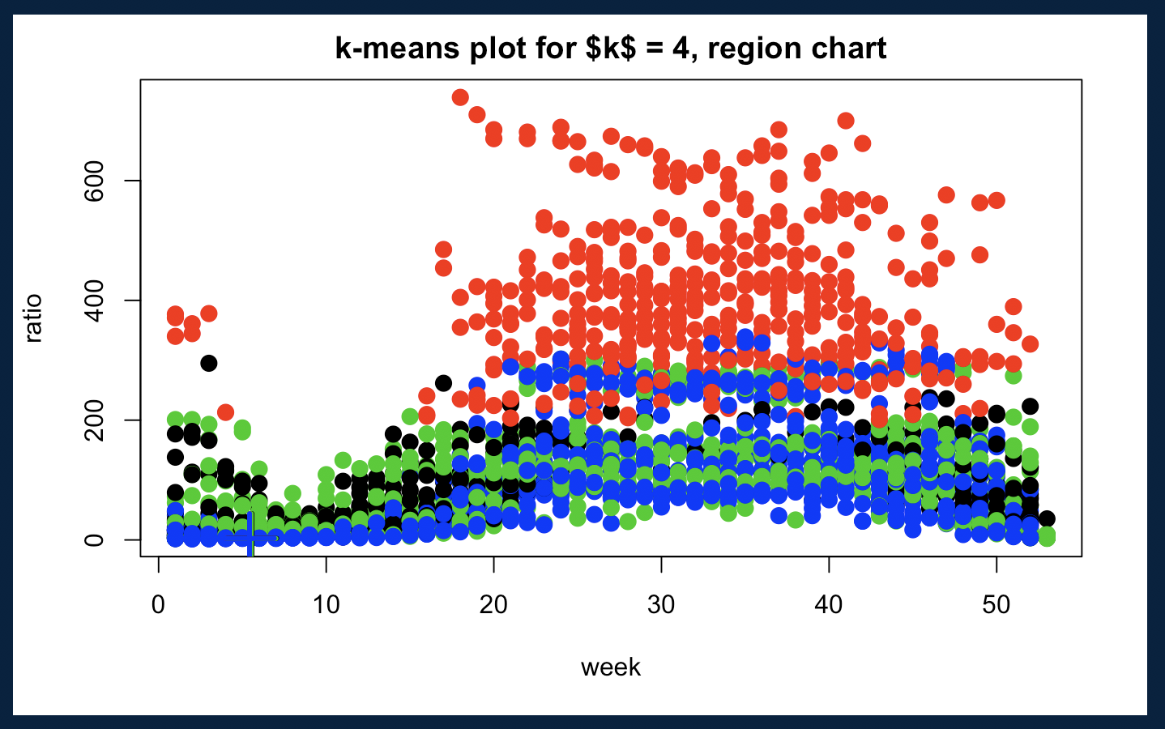
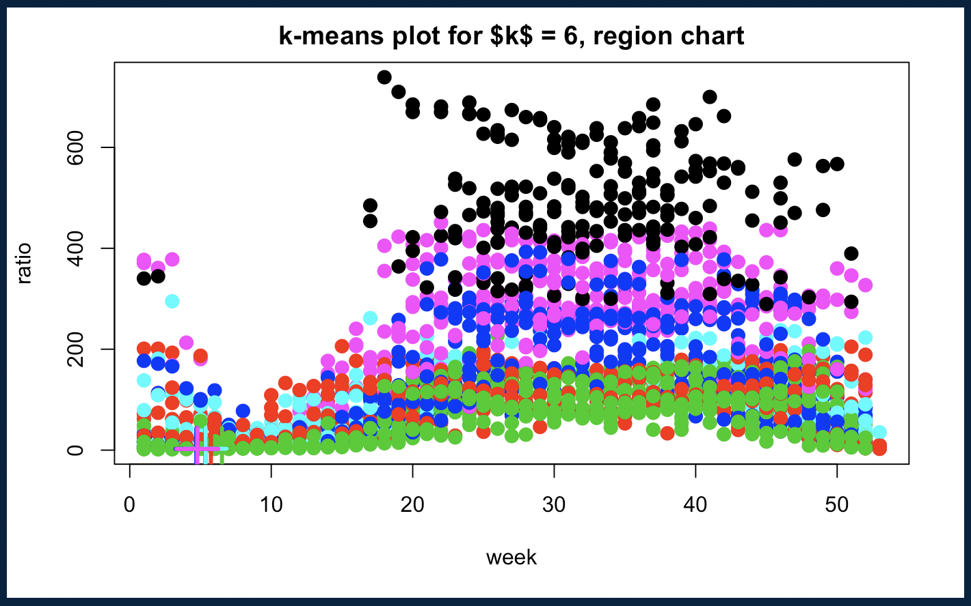
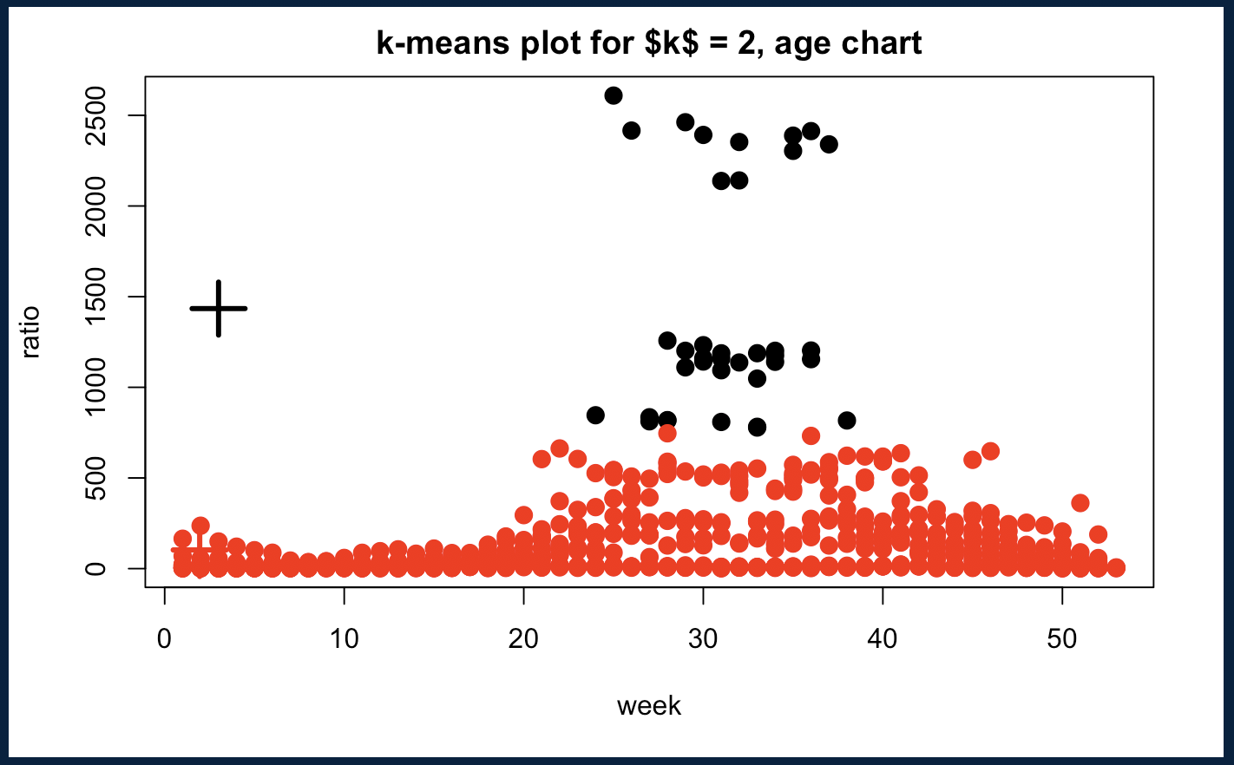
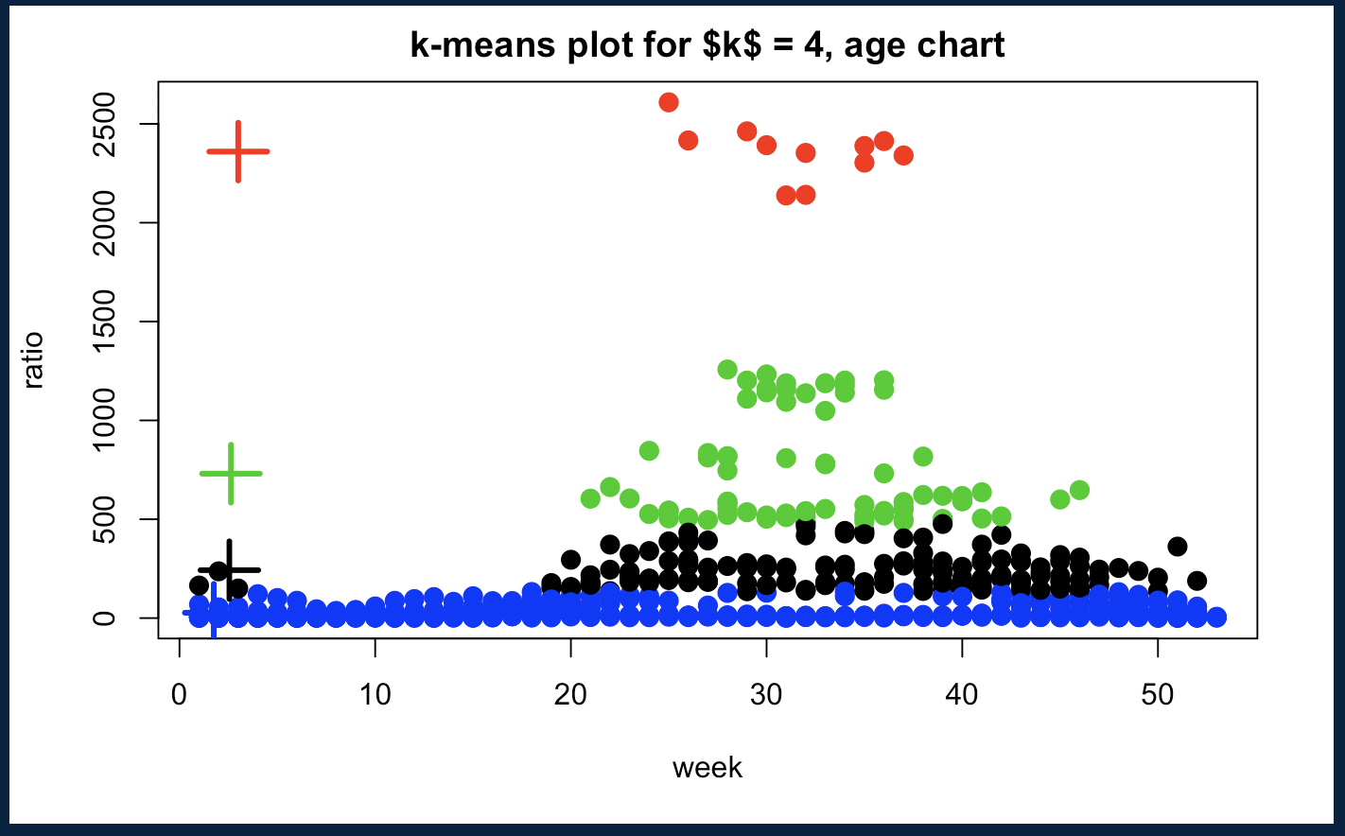
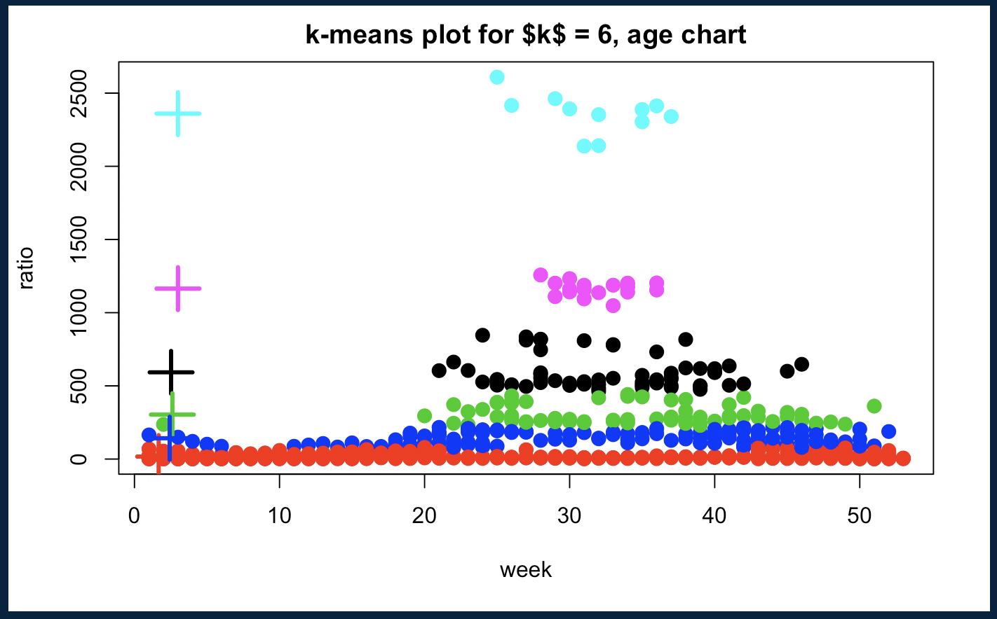
Cross Validation with different k-means

Slide 21
Conclusion
Linear relationship exists between Pneumonia and Influenza
Significant level summary
Region, age group, season show significant influence towards the relationship
Week has a moderate significant value
Year in general is not a significant variable for this model
With r-square > 0.3 for model of both chart, the linear regression model can be considered a good fit
K = 6 has the largest betweenss and smallest tot.withinss
better choice

Slide 22

Q & A
Thank you

